Slide 1
Current Eating Trends
William Stoddard, David Schwartz, Alex Clayton

Slide 2
Our Questions
Are fast food restaurants more popular than dine-in restaurants?
Are people consuming more fast food than in previous years?
Is ease of access of food becoming an increasingly important factor to consumers?

Slide 3
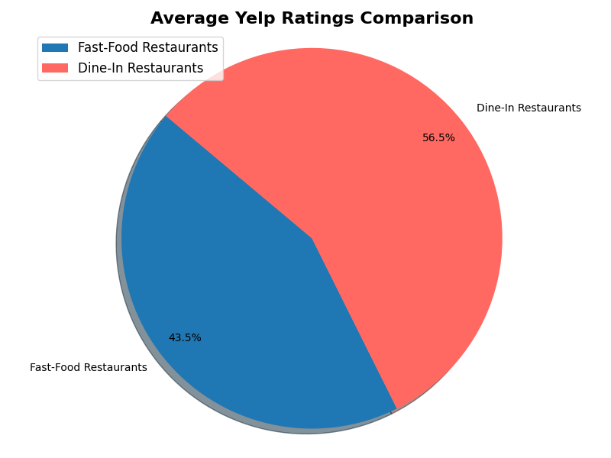
Fast Food vs. Dine In
Yelp Ratings
Fast-food restaurant ratings are generally lower than dine-in restaurant ratings on Yelp.
Of the given restaurant chains, Cracker Barrel had the highest mean rating with 4.05 stars. McDonalds had the lowest mean rating with 1.75 stars.

Slide 4
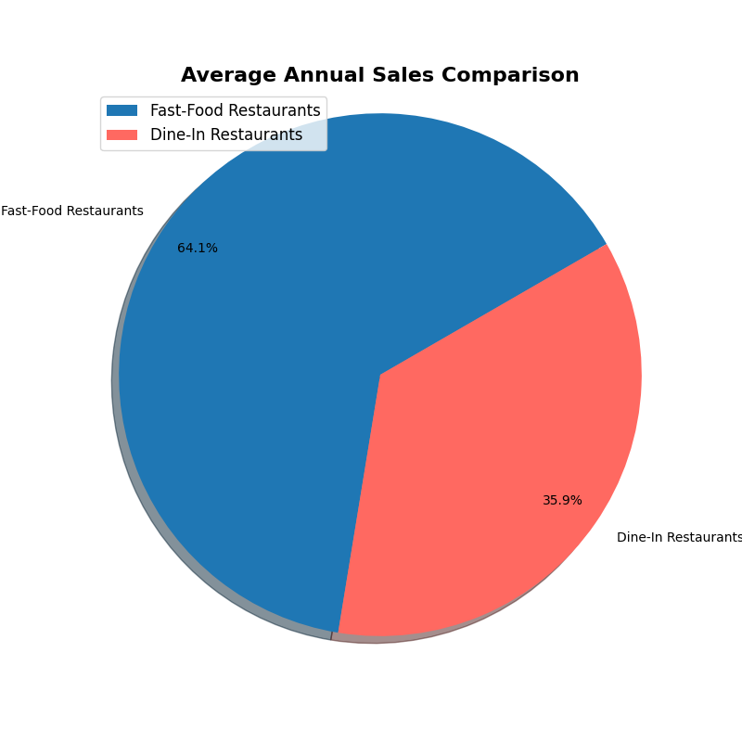
Fast Food vs. Dine In Annual Sales
Even though dine-in restaurants have higher ratings on Yelp, fast-food restaurants have much higher annual sales.
McDonald’s, with the lowest Yelp rating, also have the highest annual sales in 2022 with over $23 billion dollars.
The correlation coefficient for annual sales vs yelp reviews is -0.54 which signifies a negative correlation.

Slide 5
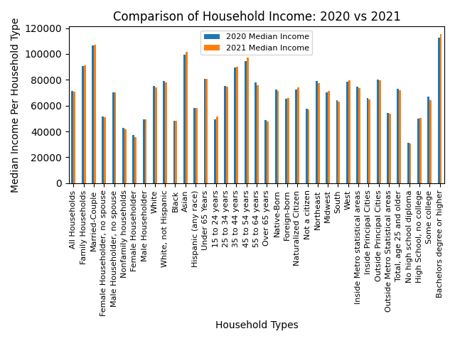
Household Incomes Over the Years
In our study, we took a look at household incomes per types of households between the years 2020 to 2021.
By looking through each type of household in the graph to our left, we can see a majority of the median incomes have increased from 2020 to 2021.
While this does not 100% confirm that people are eating out more often, it does help boost the probability that people have more disposable income to spend.
Data was acquired through the US Census. https://www.census.gov/topics/income-poverty/income/data/tables.html

Slide 6
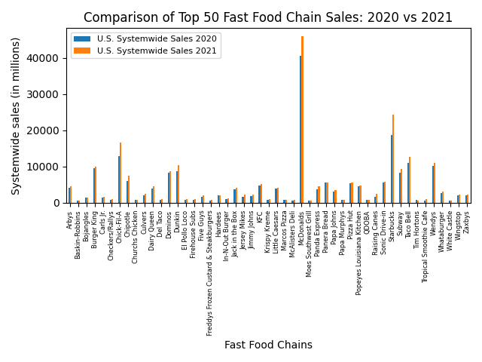
Top Fast Food Chains Sales
Now that we have looked at Household median incomes, we took a look at the Top 50 Fast Food chains sales for the same years.
Across the board, nearly every restaurant increased their systemwide sales or at least matched the prior years.
We could not prove that there is a correlation between increasing median incomes and sales per restaurant. But it is theorized that when incomes increase, people are willing to spend more. And the fact these restaurants had increasing sales helps support that.
Data was acquired through QSR magazine and Kaggle.com by searching Top 50 Fast Food Chains for each year.
https://www.qsrmagazine.com/search?search=top+50+fast+food+chains&sort_by=search_api_relevance&sort_order=DESC

Slide 7
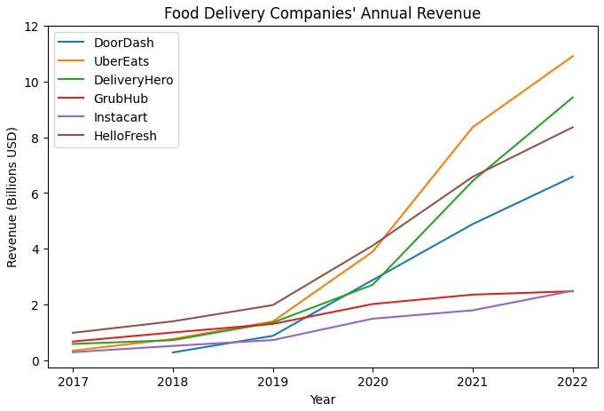
Success of Food Delivery Services
Surge of growth starting in 2019
Largely due to the pandemic
Companies still see steady growth
No one company has a monopoly on the market, despite the simplicity of the service

Slide 8
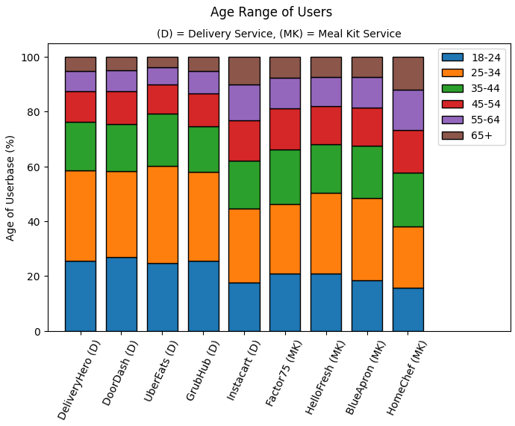
Age Distribution Among Users
Restaurant delivery services see more users from younger age groups
Meal kit services see more users from older age groups
Majority of users for all services are in the 25-34 age range

Slide 9
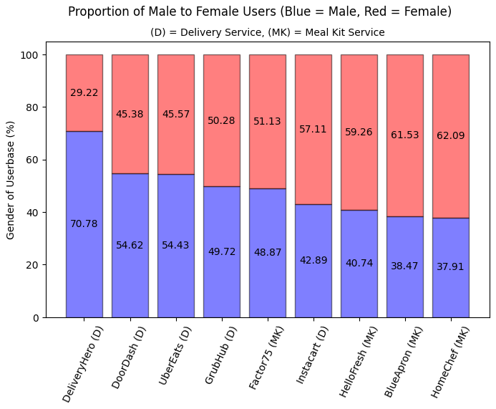
Gender Distribution Among Users
Restaurant delivery services show a higher male user base
Meal kit delivery services show a higher female user base

Slide 10





Conclusions
People appear to be eating out more as shown by the increase of restaurant revenue
Not only are fast food restaurants seeing an increase in revenue, so are the services that deliver from those places
In addition, an increase in revenue of meal kit services such as HelloFresh could signify a trend towards simplifying meal preparation
The continual success of both fast food and delivery companies shows that people are willing to pay for ease of access, even at the cost of quality

Slide 11
Thanks for Listening!

